Slide 1
FLOWERS
by Madhumita Palla

Slide 2
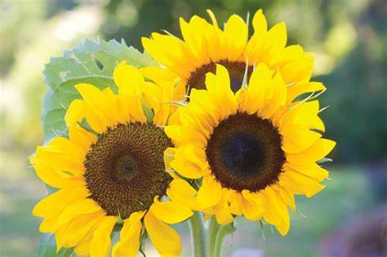

Slide 3
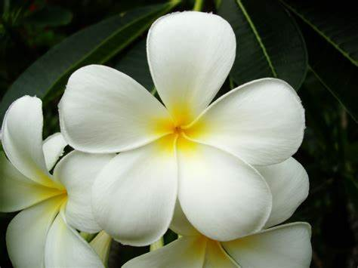

Slide 4
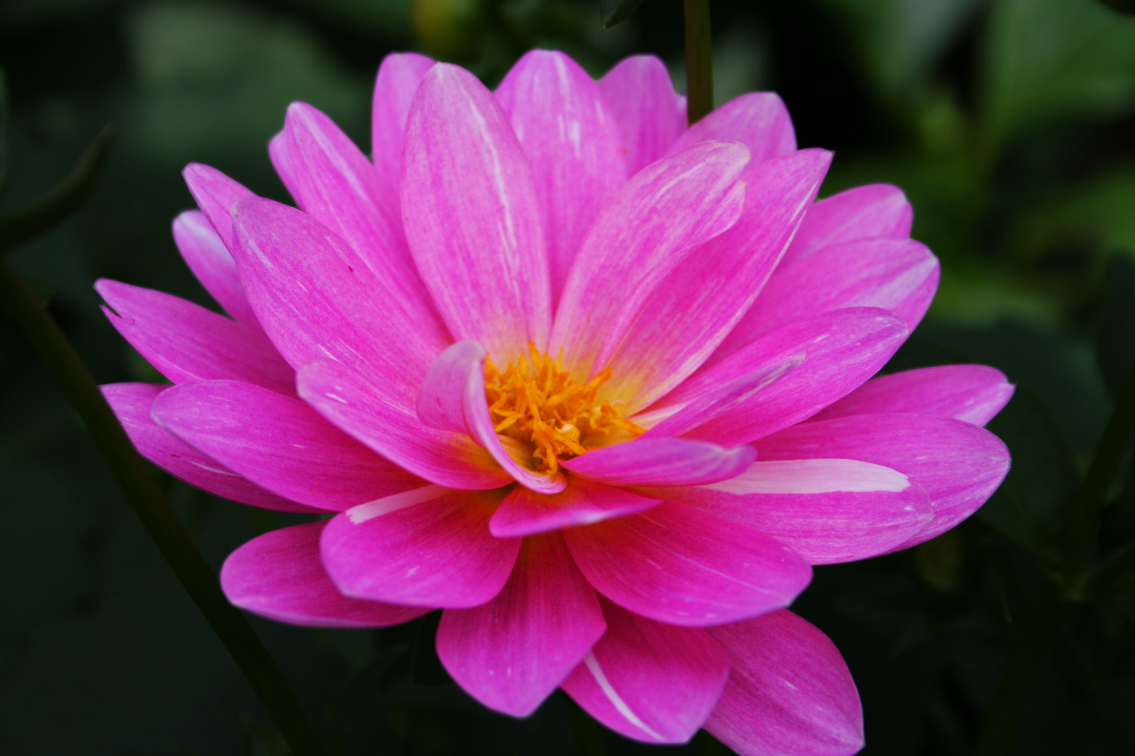

Slide 5
